Slide 1
Simulation of TE Application Landscape Scenario 1 and 5

Slide 2
Scenario 1: Peak Heat Day and Energy Supply

Slide 3
Scenario 1: Peak Heat Day and Energy Supply
Summary: The grid is severely strained in capacity and requires additional load shedding/shifting or storage resources. Narrative: The weather has been hot for an extended period, and it has now reached an afternoon extreme temperature peak. Electricity, bulk-generation resources have all been tapped and first-tier DER resources have already been called.The goal is to use TE designs to balance energy supply and demand in the minutes to hours range via customer demand response.

Slide 4
Basic Ideas
Allow buyer bidders(consumers) and seller bidders(prosumers: DERs) to participate in the market. —> (set our market mode to NONE, which is the double-auction mode)
Allow Transactive Controllers (Controller provides price-responsive appliance control and updates appliance's set point) to bid in the market. The controller bids the current monetary demand by the appliance to an auction object (TE market). As the energy price increases compared to the average price, the controller will adjust the setpoint to use less power to balance the entire grid. —>(switch the bid_mode of controllers to ON)

Slide 5
Model Design
I utilized model_test_market_attack.glm model which declares various modules, classes, and objects to simulate this scenario.
Clock - Simulation runs from 2009-06-01 09:00:00 to 2009-06-01 20:00:00 in timezone PST + 8PDT
#set minimum_timestep = 60
Climate - TN-Nashville.tmy2 file that contains Nashville’s climate data
Market - auction object that has the special_mode of BUYERS_ONLY (no sellers are on the system) by default.
Controllers (53 instances) - controllers that bid the appliance’s current demand based on the price back from the market. Their bid_mode are OFF by default.
……

Slide 6
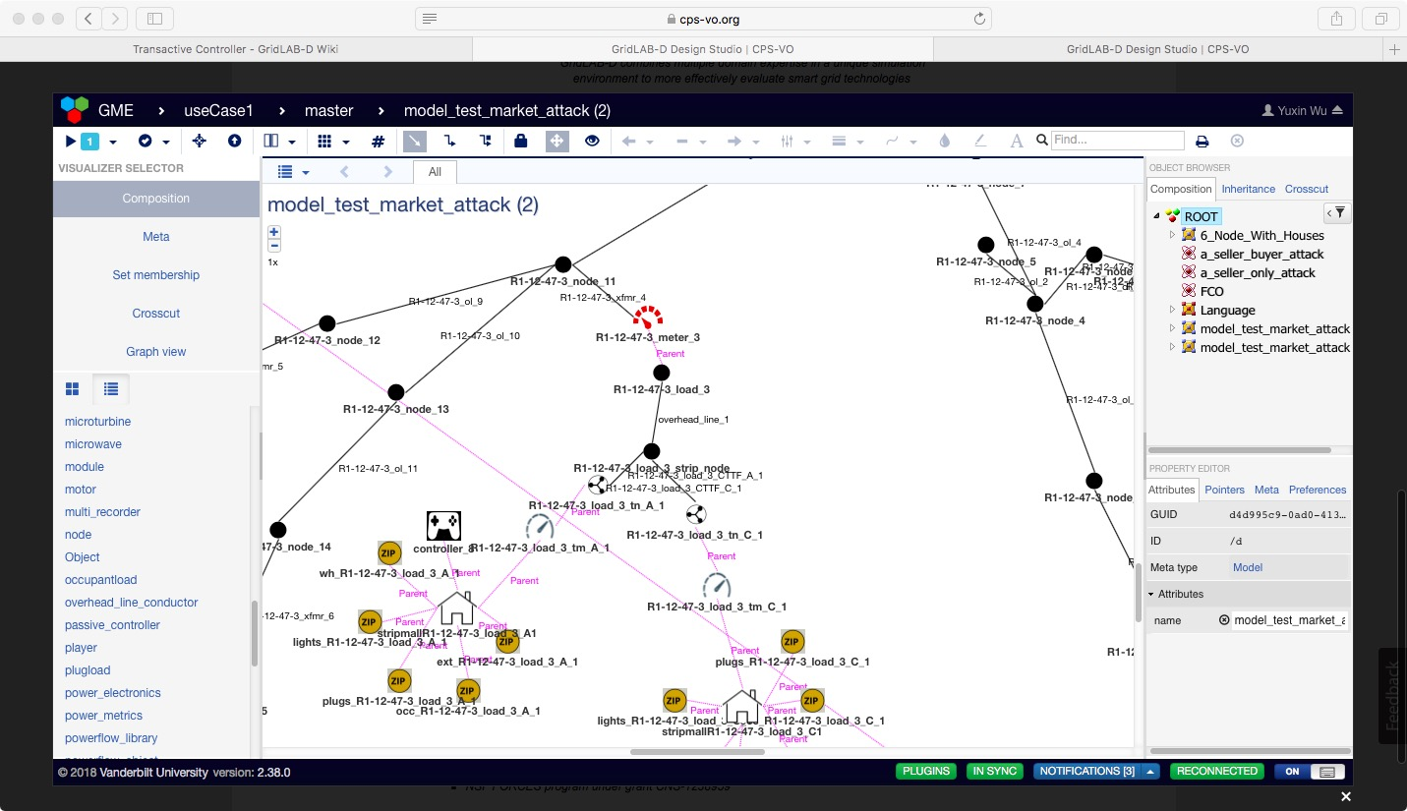
Part of the model on GridLab-D Design Studio

Slide 7
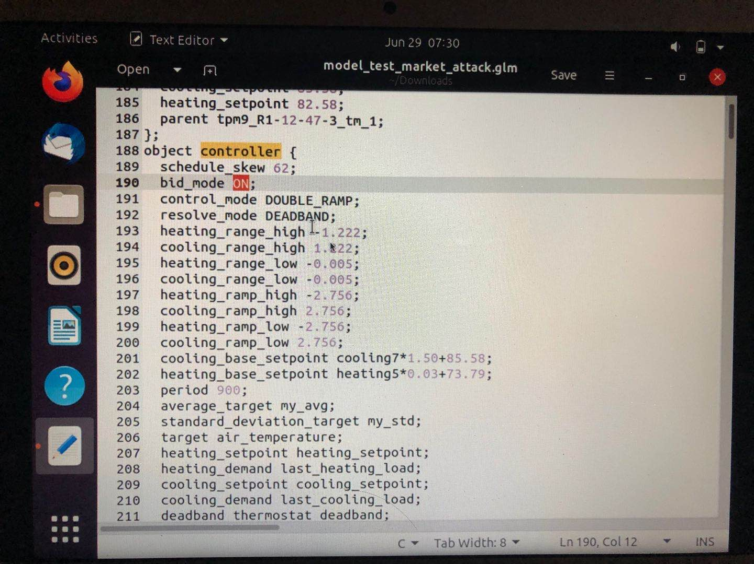
Source Code

Slide 8
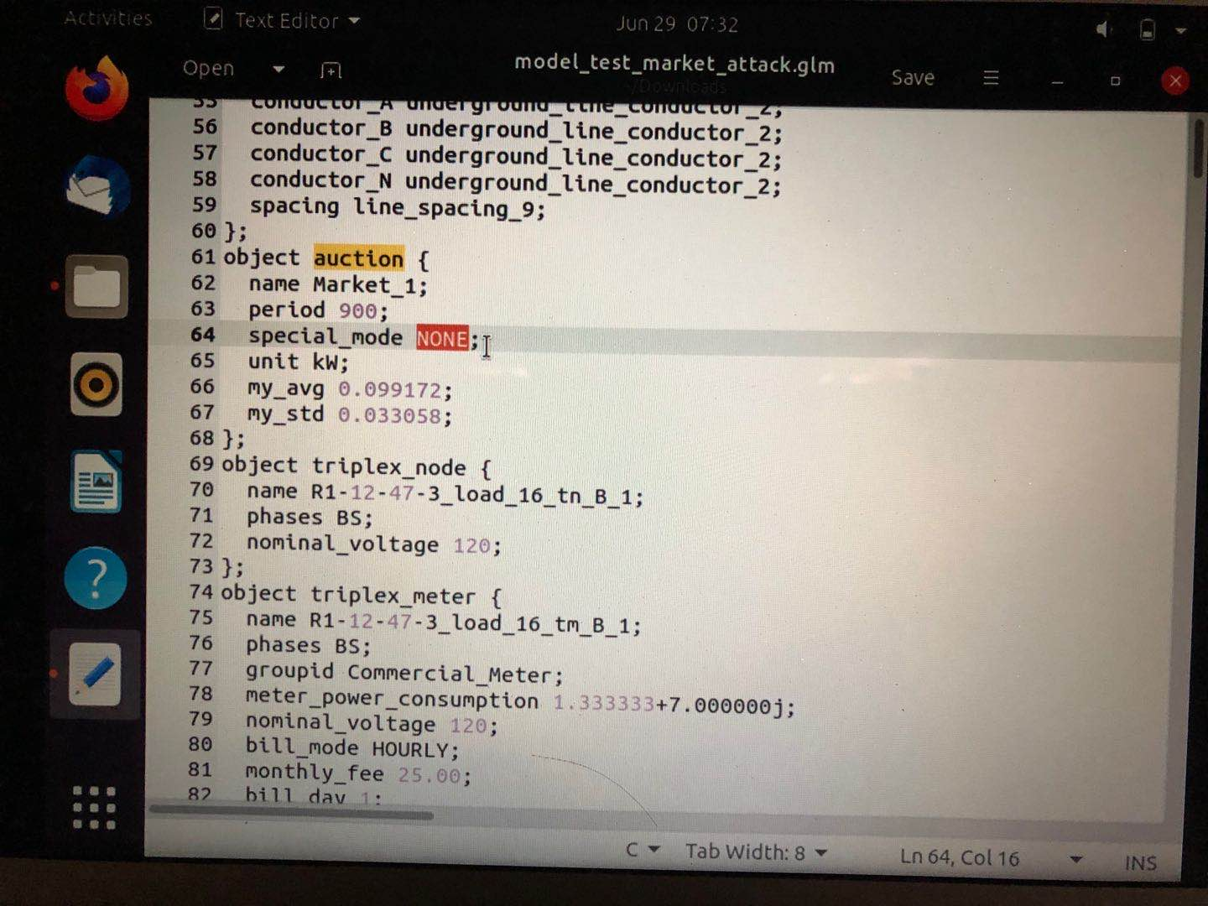

Slide 9
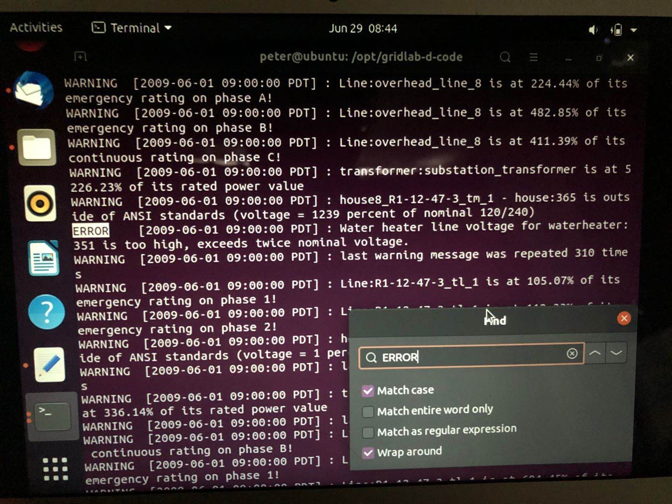
Simulation Result

Slide 10
Scenario 5: Islanded Microgrid Energy Balancing

Slide 11
Scenario 5: Islanded Microgrid Energy Balancing
Summary: When power fails on the main grid, the microgrid controller switches to islanded mode with local generation and load control. TE designs are used to balance the interests of various microgrid participants (e.g., buildings with different owners, homes, commercial and industrial facilities) and other DER. In this scenario, the main grid power is lost and the microgrid goes to islanded mode and operates using transactive approaches to balance supply and demand at minimum cost to the microgrid operator.

Slide 12
Basic Ideas
In the whole grid (main grid+ microgrid), there should be a switch implemented that connects the main grid and the microgrid.
Same method used in use case 1. We need a market to balance the energy supply and demand in the microgrid when it operates in island mode.

Slide 13
Model Design
I constructed microgrid_test.glm model which has 15 houses (10 houses in the main grid, and 5 in the microgrid)
Clock - Simulation runs from 2009-06-01 09:00:00 to 2009-06-01 20:00:00 in timezone PST + 8PDT
Climate - TN-Nashville.tmy2 file that contains Nashville’s climate data
Market - auction object that has the special_mode of NONE(both sellers and buyers are on the system)
Houses and Controllers (15 instances) - controllers that bid the appliance’s current demand based on the price back from the auction. Their bid_mode is ON
……

Slide 14
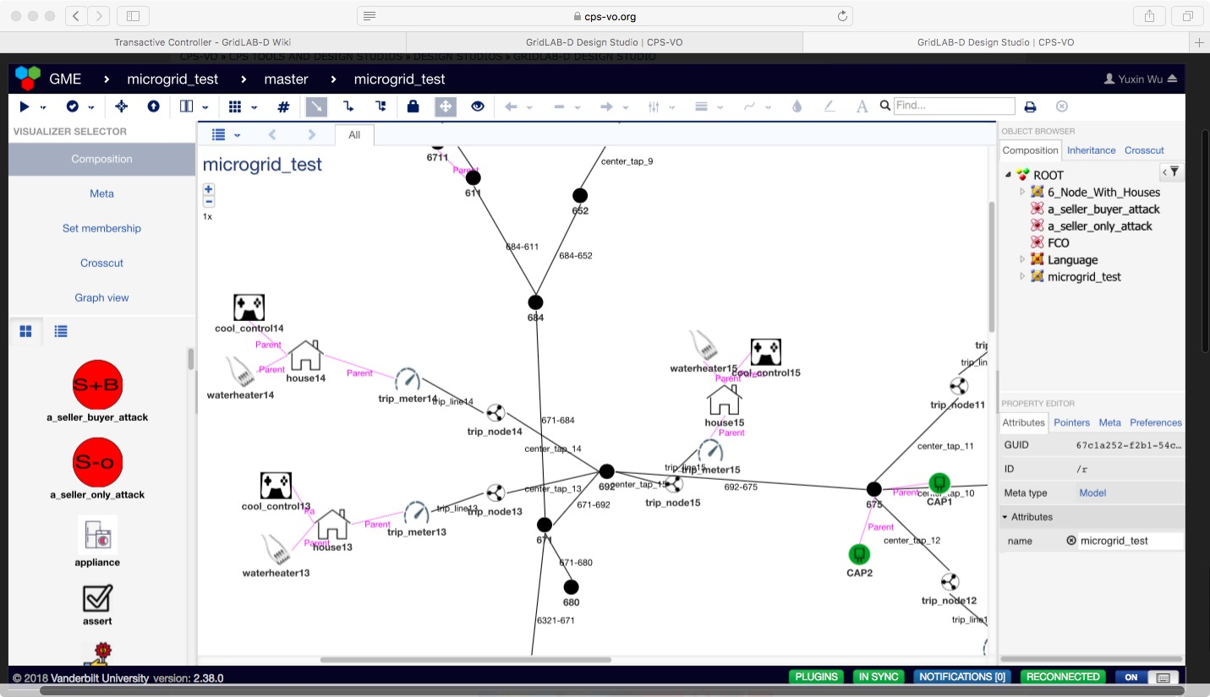
Part of the model on GridLab-D Design Studio

Slide 15
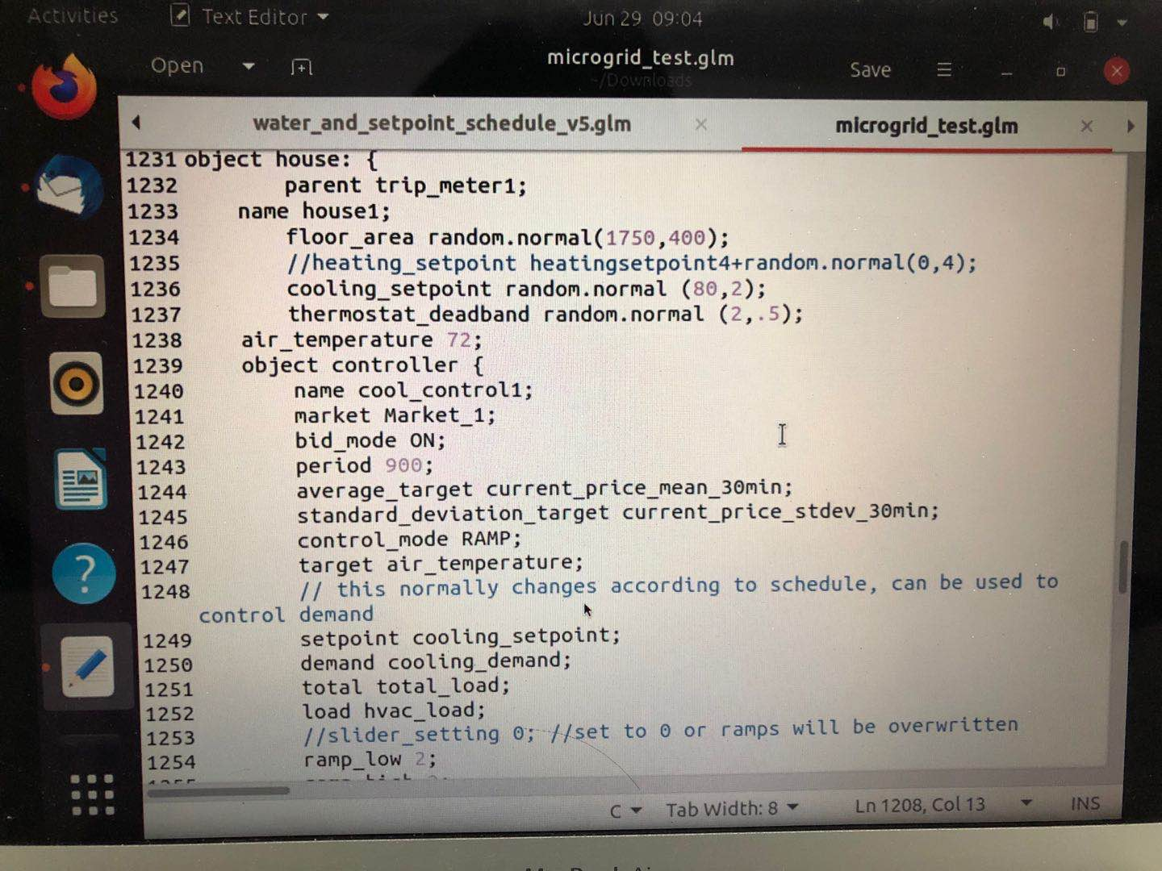
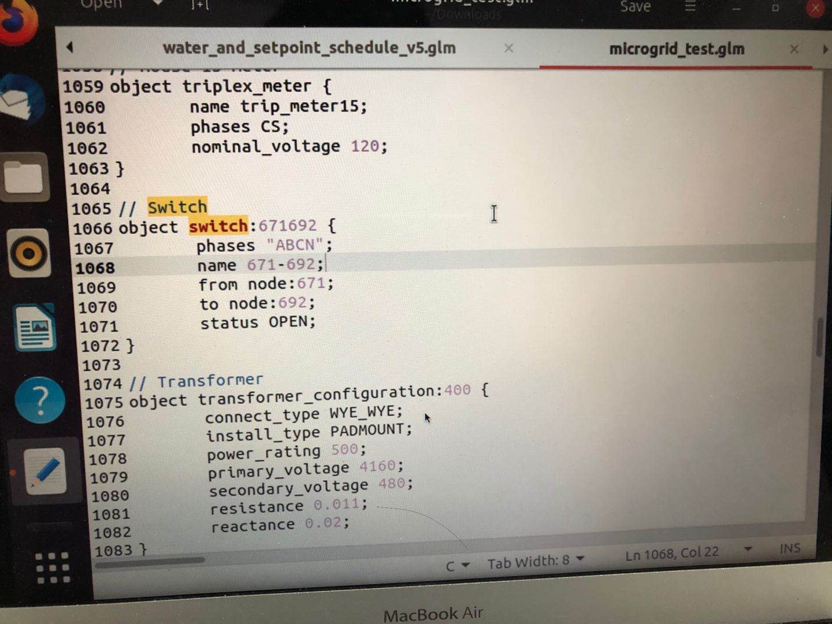
Source Code

Slide 16
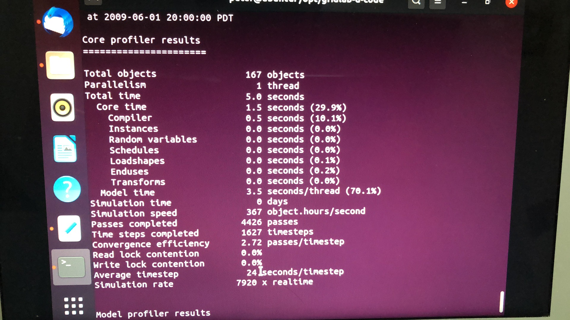
Simulation Result

Slide 17
